Slide 1
Improvements to GT Helium Loop Proceessing
Michael Lanahan
07.06.2021

Slide 2
Summary
Interval Selection
Number of samples determination
Criteria for selection
Fluid property evaluation
CoolProp/Refprop 10 vs. GASPROP3
Non-linear equation solving
Legacy (Picard iteration) vs. Powell’s method
Uncertainty propagation using uncertainties
Sensor Information storage
Theory
Example

Slide 3
Example plot

Slide 4
Interval Selection

Slide 5
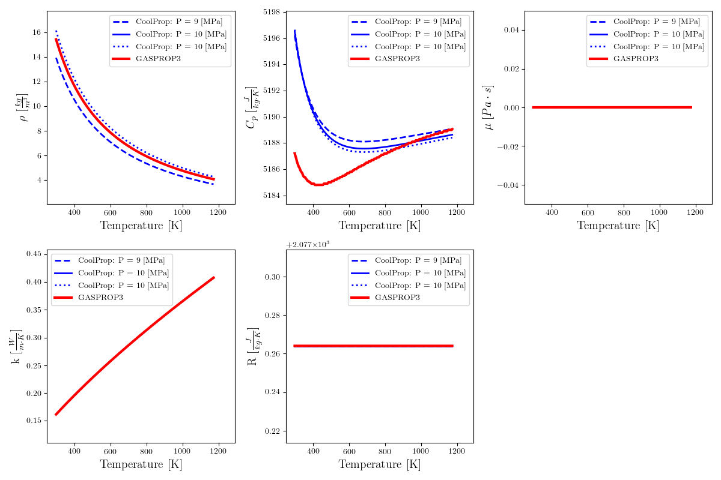
Properties
Motivation:
The CoolProps package uses the model of [insert author of thesis here], which is a cubic equation of state, and is also the latest Helium model used in REFPROP10 – the NIST fluid database package.
GASPROP3 does not consider most properties to be a function of pressure
Figure: Comparison of GASPROP3 (Legacy code) vs. CoolProps package property values for three different iso lines of pressure for Helium

Slide 6
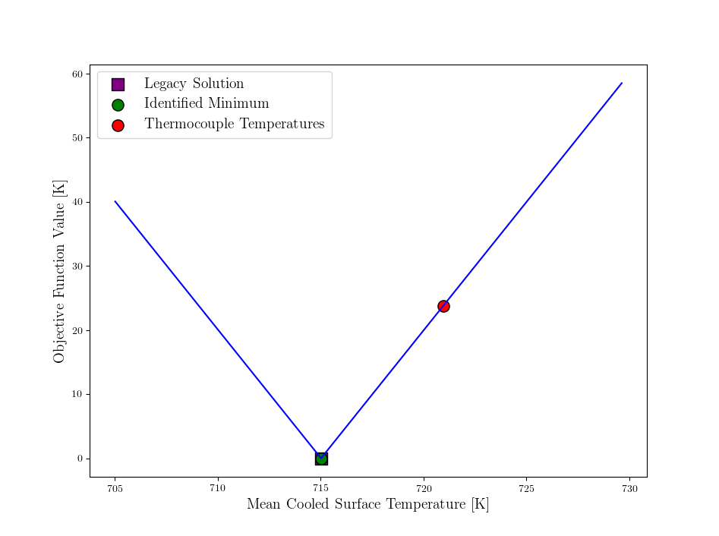

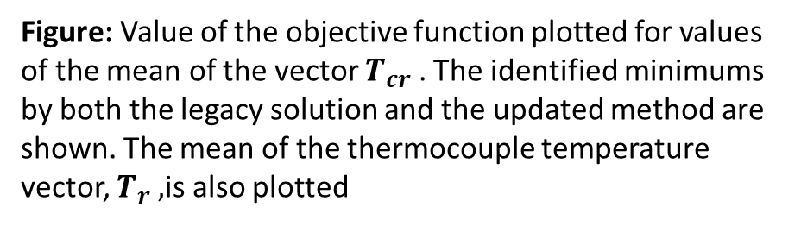
Equation Solving
In particular, we are concerned with the equation
$||T_{r}−\frac{q"δ_{tc}}{k_{s}}−T_{cr }||$ subject to
$$k_{s}=k_{s}\left(T_{m}\right)$$
$$T_{m}= \frac{T_{r}+T_{cr}}{2}$$
Motivation:
more robust solver (Powell method) that can handle diverging values.
Single line function call that can be debugged and interpreted more easily
Figure: Value of the objective function plotted for values of the mean of the vector $T_{cr}$ . The identified minimums by both the legacy solution and the updated method are shown. The mean of the thermocouple temperature vector, $T_{r} ,$is also plotted

Slide 7
Uncertainty Propagation

